Slide 1


SEL LabVIEW Tips & Tricks
- Code Layout & Organization
- Shortcuts and Common Functions
Blake Otting
March 24, 2009

Slide 2
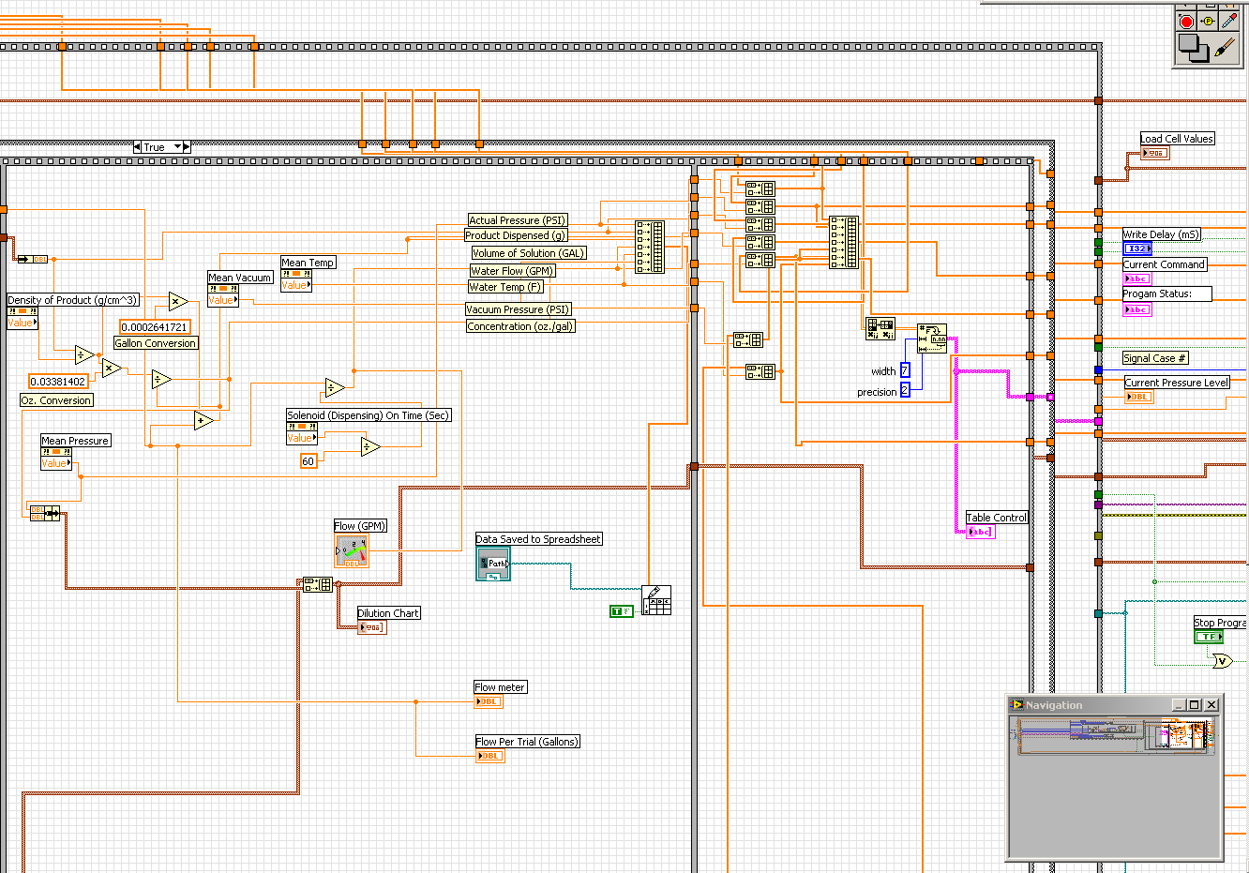
Code Organization & Layout
Disorganized and Confusing Example
Difficult to see what wire goes where
Labeled, but difficult to keep a ‘decal’ label associated to a wire.
Code does not fit into one screen

Slide 3
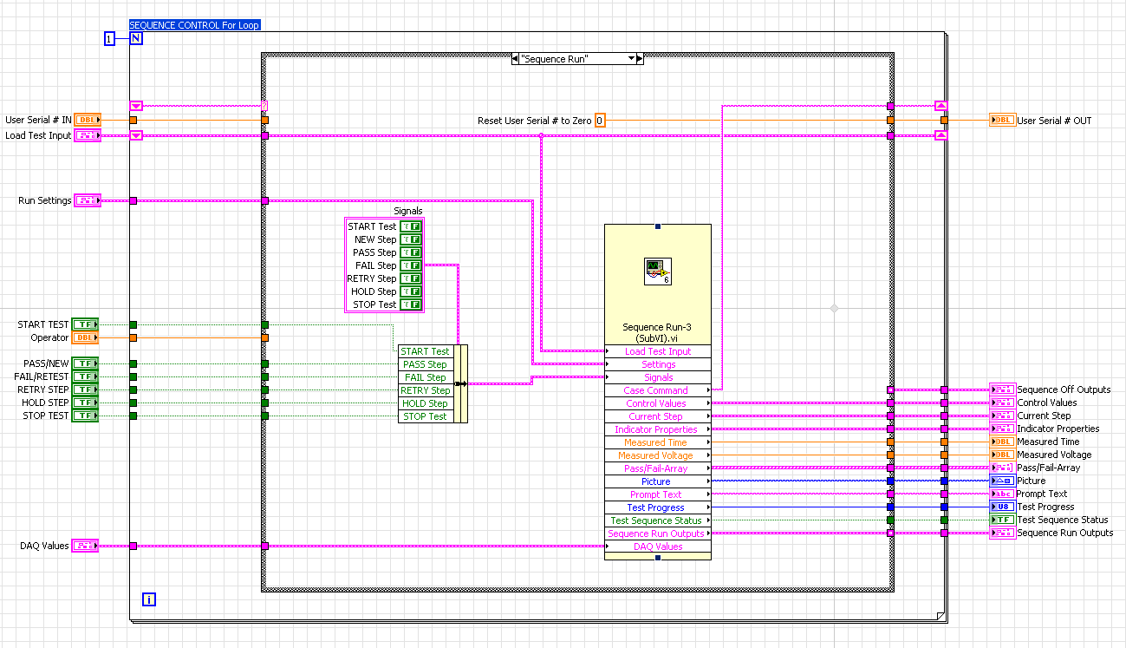
Code Organization & Layout
Organized and Straight-Forward Example
Cluster/Bundle by Name – Easily see what the wire is at a glance
Straight and flowing data lines – easy traceability and troubleshooting
SubVI used and expanded to full size to show inputs and outputs.

Slide 4
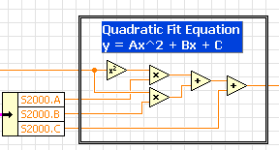

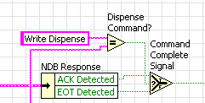

Code Organization & Layout
Suggestions
Try to keep all components of code within 1 screen-size view, if possible.
  Larger programs should use SubVI’s for ease of program flow.
  It should look more like a flow chart than a maze of wires.
Use labeling appropriately and consistently, comment code when applicable.
Avoid using property-nodes for data transfer, if possible always wire it directly.
Use clusters and arrays to manage data.
  Clusters are like the zip-ties for controlling your wiring mess.
  Arrays are good for storing a bunch of data points - like the last 10 pressure readings.
You can label the built in components to suit your use of them.

Slide 5
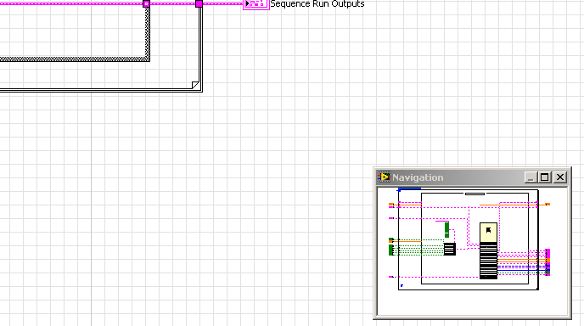
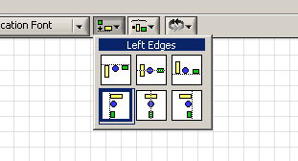
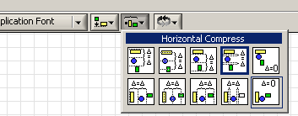
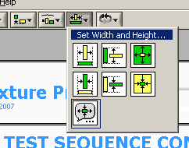
Code Organization & Layout
Suggestions Continued
Navigation window instead of ‘zoom’.
Format and align components.
Navigation Window
Item spacing: keep indicators and controls together
Useful on both front panel and block diagram.
Front Panel Object Sizes

Slide 6
Shortcuts and Common Functions
Hold down shift for faster scrolling up/down and side to side.
  Be aware that this is also a useful way to transition between case/stacked structures.
Double-Click on empty space on either the block diagram or front panel to add text or comments.
  I find this useful to jot down info for parts of the program still in progress.
Lots of keyboard controls to make use of:
  CTRL and ‘+’ or ‘-” when text is selected quickly changes size
  Holding Shift while clicking items allows multiple pieces to be grabbed at once
    This can also be done by selecting with the mouse.
  Copy/Cut/Paste work the same as Microsoft products
  CTRL and ‘E’ switches between the front panel and block diagram.
  CTRL and ‘R’ runs the program.
  The directional arrows can be used to align wires (shift works to speed up movement).
  … and many more.

Slide 7
Next Topics
Data Structuring – loop types
  Advantages and disadvantages between different code layouts
Timing / Synchronizing
  Why LabVIEW is so complicated to ‘just time or run something’ or at least how to simplify this.
Efficiency and program execution speed – and why this important.
  Performance analysis
  Bottle-neck tracing
Code Review Discussion.

Slide 8
Questions?

